Slide 1

ARTIFICIAL
INTELLIGENCE
Integrate & level-up with AI
PRESENTED BY
THEO EL KHOURY

Slide 2

INTRODUCTION
AI TOOLS
PROMPTS
AI AGENTS?
DEMO
POTENITAL
Q/A
CONCLUSION
01
02
08
09
11
14
15
16
CONTENT
00

Slide 3
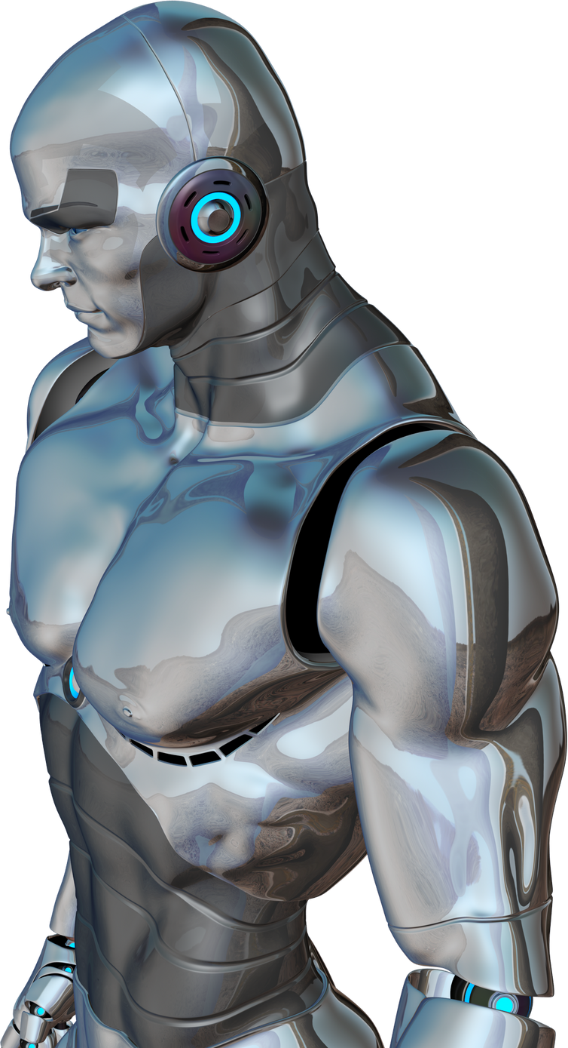
01
INTRODUCTION

Slide 4

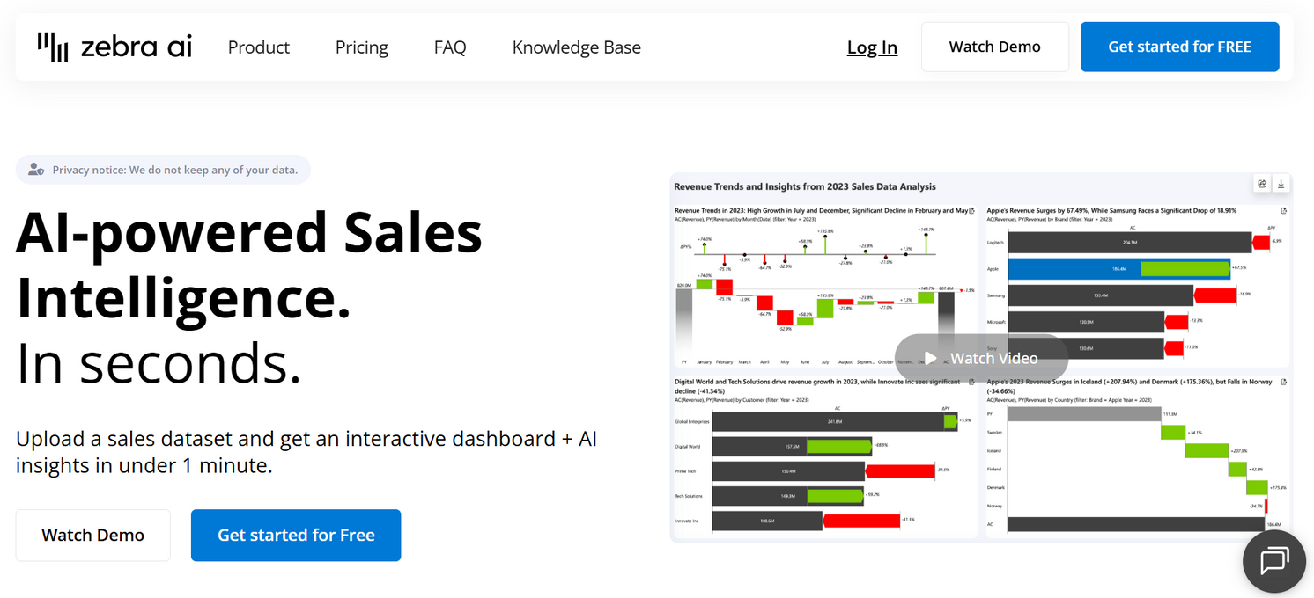
02
ZEBRA AI

Slide 5
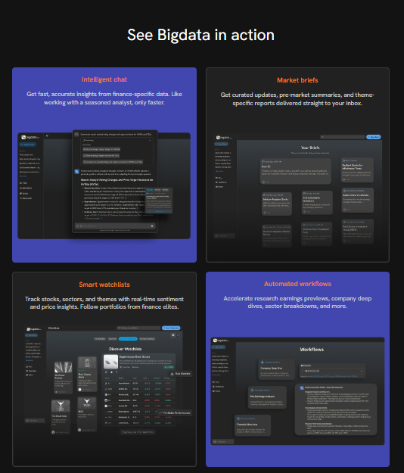

03
BIGDATA AI

Slide 6
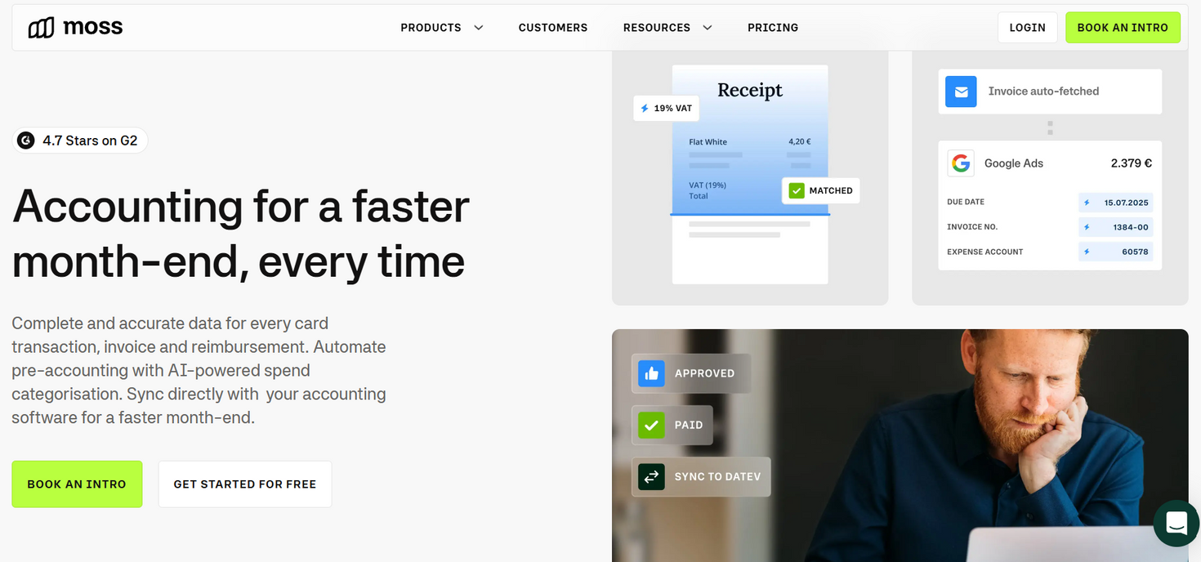
04
MOSS AI & RYDOO

Slide 7
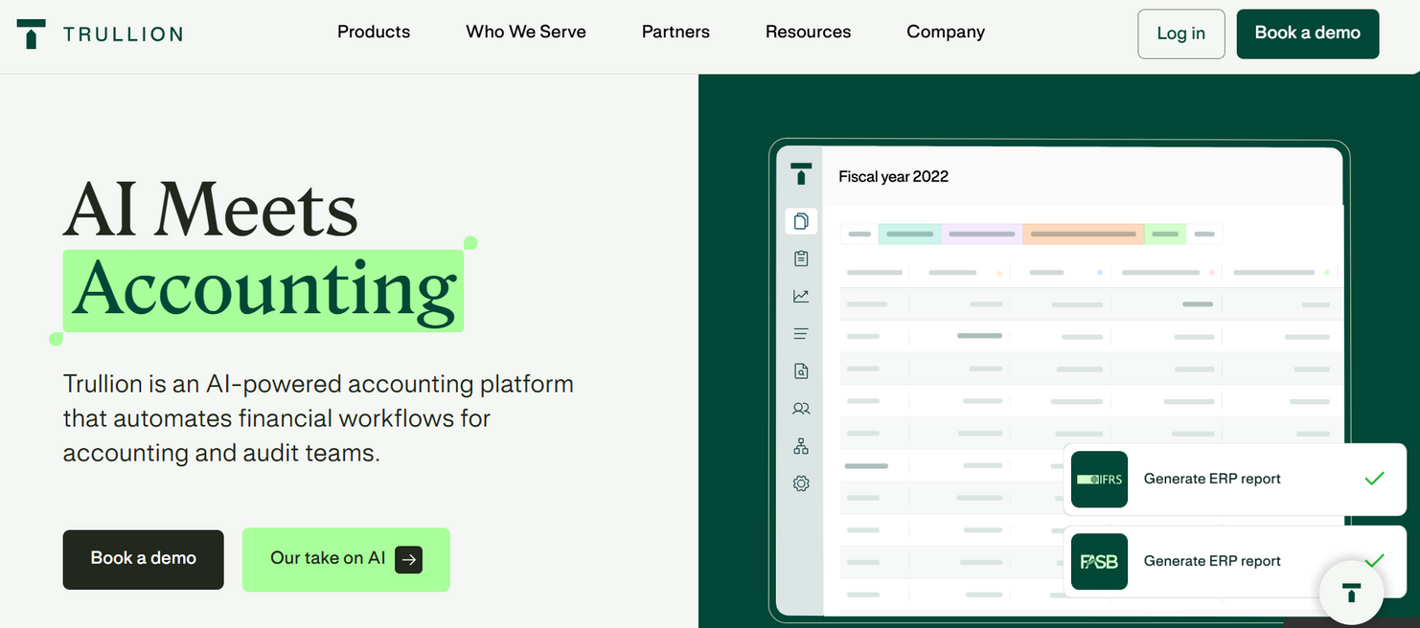
05
TRULLION

Slide 8
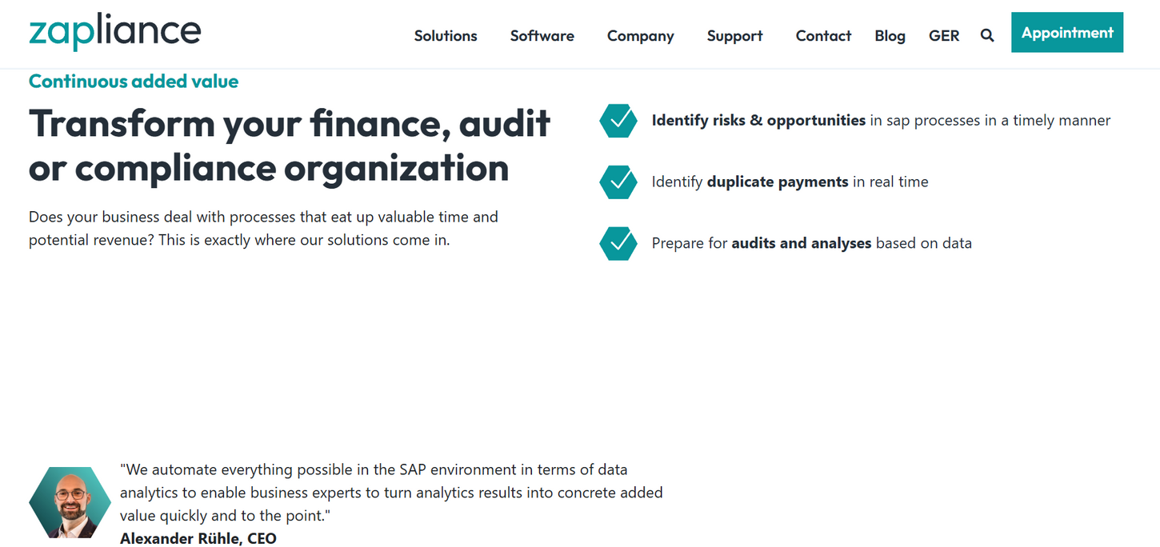
06
ZAPLIANCE

Slide 9
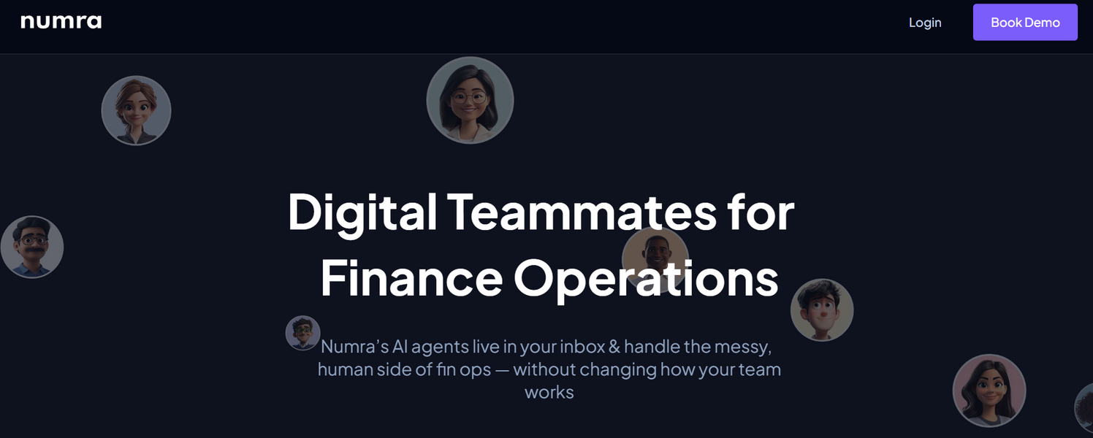
07
NUMRA

Slide 10
08
COMPLEX PROMPTS

Slide 11
09
AI AGENTS

Slide 12
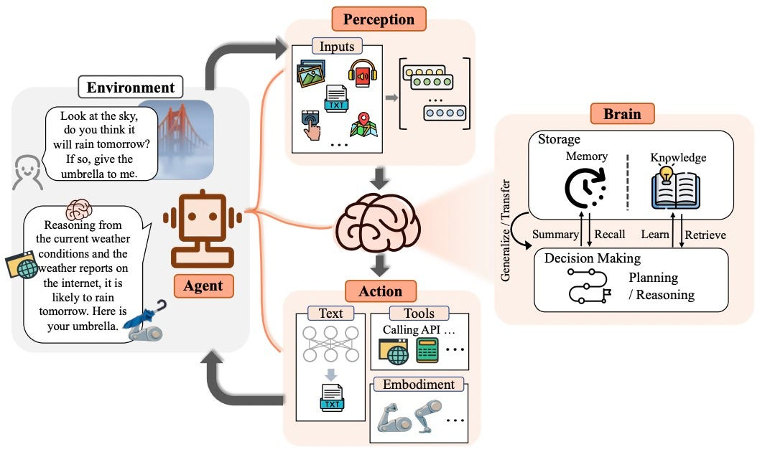
10

Slide 13
11
DEMO (N8N)

Slide 14
12
GMAIL

Slide 15
13
GOOGLE CALENDAR

Slide 16

14
POTENTIAL

Slide 17
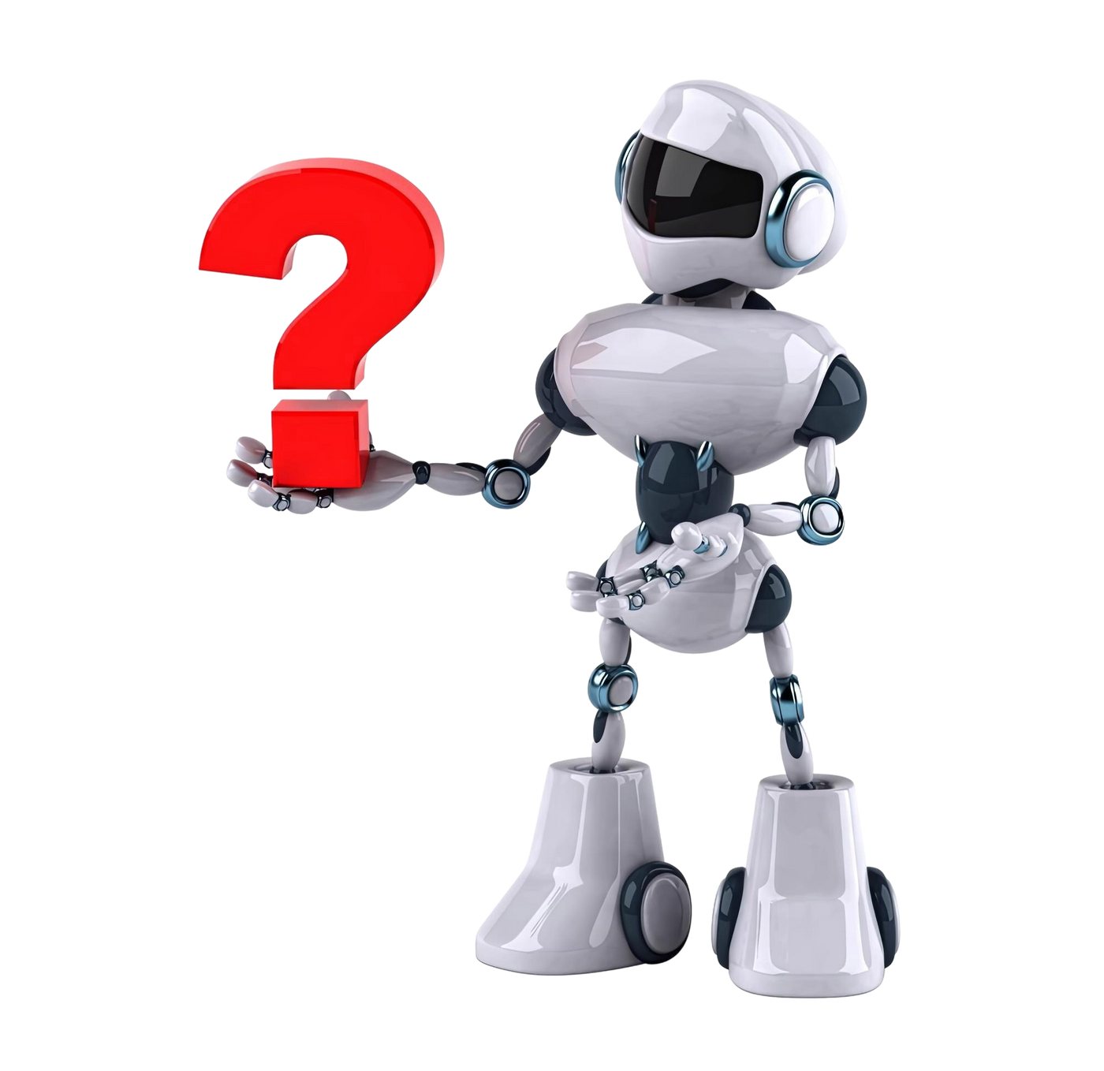
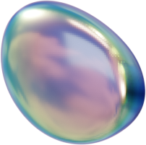
15
Q & A

Slide 18
16
CONCLUSION

Slide 19
THANK YOU
+ 961 81 185 923
Contact me
theoelkhoury45@gmail.com
theoelkhoury.com

Slide 20
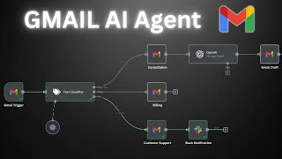
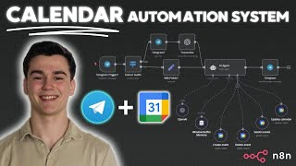
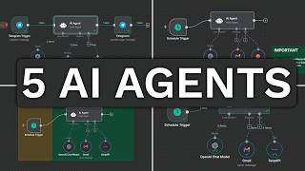
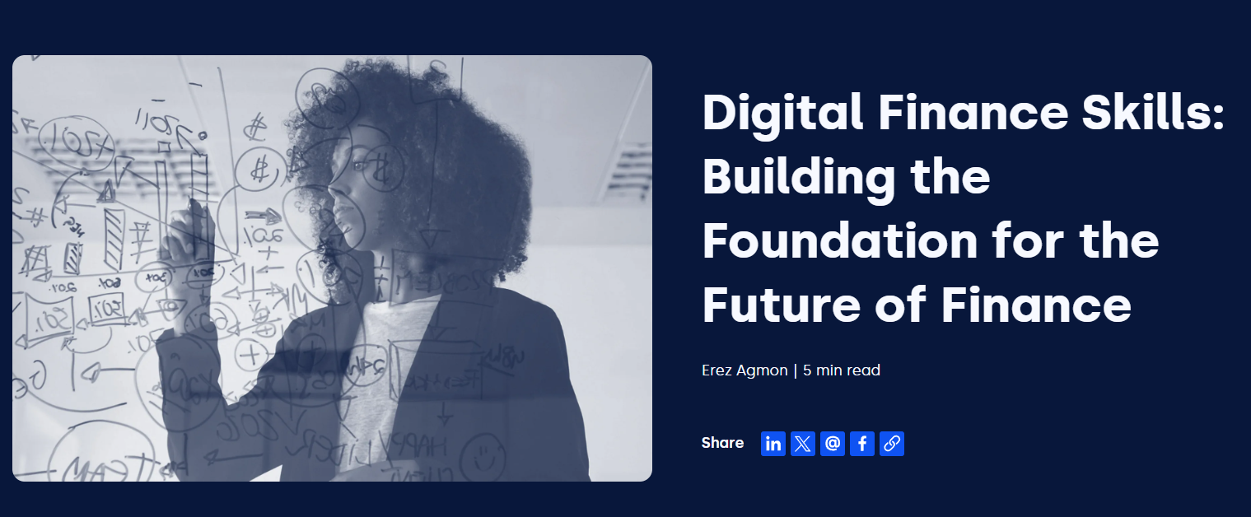
07
CONTENT TO GET INTO PROMPT ENGINEERING & AI

